Slide 1

FAMILY FEUD FAMILY FEUD FAMILY FEUD FAMILY FEUD FAMILY FEUD FAMILY FEUD FAMILY FEUD FAMILY FEUD FAMILY FEUD FAMILY FEUD FAMILY FEUD FAMILY FEUD FAMILY FEUD FAMILY FEUD FAMILY FEUD FAMILY FEUD FAMILY FE
FAMILY FEUD FAMILY FEUD FAMILY FEUD FAMILY FEUD FAMILY FEUD FAMILY FEUD FAMILY FEUD FAMILY FEUD FAMILY FEUD FAMILY FEUD FAMILY FEUD FAMILY FEUD FAMILY FEUD FAMILY FEUD FAMILY FEUD FAMILY FEUD FAMILY FE
Notes:
Family Feud Template
Introduction Slide – Family Feud!

Slide 2
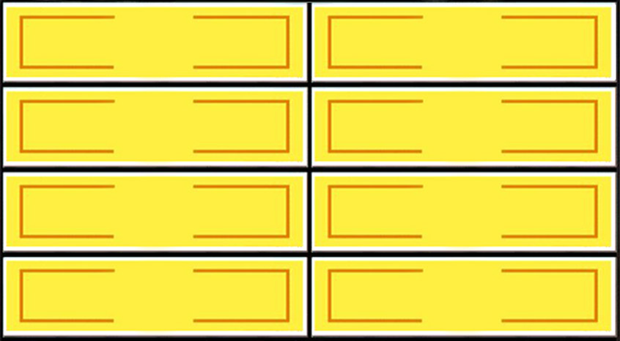






Types of trauma
children experience
Round 1
X
X
X
X
X
X
X
X
X
Witness Domestic
Violence
39
Sexual Abuse
8
Witness community
Violence
22
Physical Abuse
17
Neglect
14
X
X
X
Win
Lose
Cheer
Boo
Silence
Notes:
Family Feud Template
5 Panel Slide

Slide 3

Inaccurate Thoughts
about Child
Sexual Abuse
Round 2
X
X
X
X
X
X
X
X
X
Normal-appearing, well educated,
Middle-class people don’t
Sexually abuse children
31
By asking about the abuse or talking
about the therapists Or police can
easily implant false
memories And cause false accusations
9
It wasn’t sexual abuse if you
Did not have intercourse
25
Hundreds of innocent men
And women have been falsely
accused and sent to prison for
Molesting children
3
Children who are being abused
Will show physical evidence
Of abuse
18
If asked about abuse,
Children tend to
Lie or make
False accusations
14
X
X
X
Win
Lose
Cheer
Boo
Silence
Notes:
Family Feud Template
6 Panel Slide

Slide 4

Types of OK
touches
Round 3
X
X
X
X
X
X
X
X
X
Handshake
45
Pat on back
7
Hug
21
Tap on shoulder
15
High-5
12
X
X
X
Win
Lose
Cheer
Boo
Silence
Notes:
Family Feud Template
8 Panel Slide

Slide 5

How do people
Who abuse children
Groom kids
Round 4
X
X
X
X
X
X
X
X
X
Pays special interest to
A particular child or singles
Them out for special treatment
35
Breaks boundaries or
rules
27
Are overly physical with
The child
22
Encourages
secrecy
16
X
X
X
Win
Lose
Cheer
Boo
Silence
Notes:
Family Feud Template
8 Panel Slide

Slide 6
Not OK Touches
Round 4
X
X
X
X
X
X
X
X
X
Someone touching your
Private Parts (Vagina, Penis,
buttocks, Breast, etc.)
35
Any touch that makes you
Feel uncomfortable
28
Someone asking you to
touch their private parts
20
X
X
X
Win
Lose
Cheer
Boo
Silence
Notes:
Family Feud Template
4 Panel Slide

Slide 7
What is sexual abuse?
Round 5
X
X
X
X
X
X
X
X
X
When someone gives
a child a Not OK touch
35
Any type of sexual act inflicted
on a child by someone the
child is acquainted with
5
child abuse in which an
adult or older adolescent uses
a child for sexual pleasure
28
It is never right for another
Person to sexually abuse
A child !!
20
Illegal sex acts performed
against a minor by another
person
12
X
X
X
Win
Lose
Cheer
Boo
Silence
Notes:
Family Feud Template
5 Panel Slide

Slide 8
T/F The best way to
Handle sexual abuse is to
Forget about it
Round 1
X
X
X
X
X
X
X
X
X
False
35
X
X
X
Win
Lose
Cheer
Boo
Silence
Notes:
Family Feud Template
1 Panel Slide

Slide 9
T/F By the age of 18, 1
Out of 3 girls and 1 out
Of every 6 boys experience
Some form of sexual
abuse
Round 1
X
X
X
X
X
X
X
X
X
True
35
X
X
X
Win
Lose
Cheer
Boo
Silence
Notes:
Family Feud Template
1 Panel Slide

Slide 10
T/F ---Ending the secrecy about
Youth sexual abuse can
Help you heal. There is
No evidence that talking
About sexual abuse will make
Kids feel worse
Round 1
X
X
X
X
X
X
X
X
X
True
35
X
X
X
Win
Lose
Cheer
Boo
Silence
Notes:
Family Feud Template
1 Panel Slide

