Slide 1

Jeopardy
Learning & Empowerment for Adoptive Families (LEAF)
Notes:
PowerPoint Template Created by Educational Technology Network. www.edtechnetwork.com 2009

Slide 2
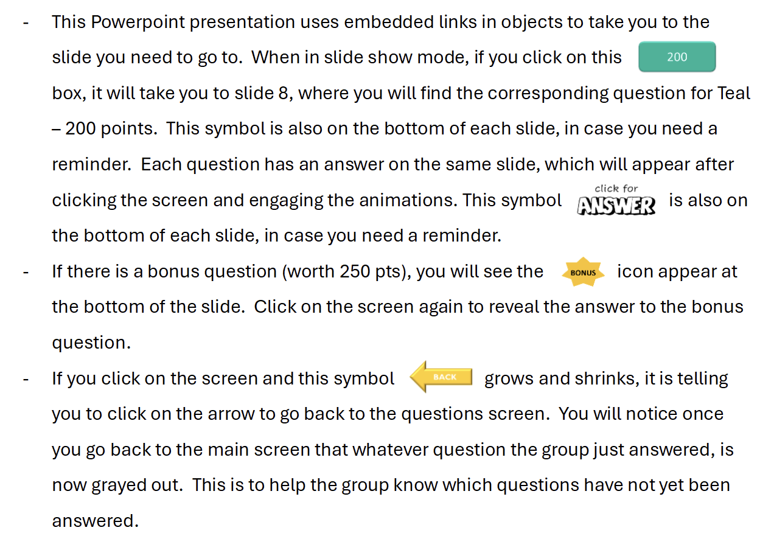
Instructions and Tips for Facilitators:

Slide 4


Jeopardy
Coping
W.I.S.E. Up
Adoption
Mystery
100
100
100
100
200
200
200
200
300
300
300
300
400
400
400
400
500
500
500
500

Slide 5
Coping – 100 Points
This zone is when you space out, shut down, or disconnect from what you are feeling.
2025
Notes:
Additional Questions That Can be Used:
What does it mean if you are in the BLUE Zone?
What does it mean if you are in the RED Zone?
Name two other coping skills.
Adam teases you in the cafeteria about being adopted. You decide to move to a different table. Which W.I.S.E. Up method did you use?
Name something that can widen your Green zone?

Slide 6
Coping – 200 Points
What are some strategies that can be helpful when you are in the BLUE zone?
Bonus (50 Points): What are some strategies that can be helpful when you are in the RED zone?
2025

Slide 7
Coping – 300 Points
Bennett is excited and happy to be back at school. He is struggling to stay in his seat, but is ready to learn.
What ZONE is Bennett in?
2025

Slide 8
Coping – 400 Points
What does belly breathing (or any other type of breathing exercise) do for your body?
2025

Slide 9
Coping – 500 Points
When something causes such a strong emotion that we can get bumped out of our Green zone, it is called a ________ ?
2025

Slide 10
W.I.S.E. Up – 100 Points
What does one of the
letters in W.I.S.E. Up
stand for?
Bonus (50 Points): What do the other 3 letters in W.I.S.E. Up stand for?
2025

Slide 11
W.I.S.E. Up – 200 Points
Billy says, “Is that your real family?” You reply, “Actually, it is my adoptive family.”
Which W.I.S.E. Up method did you use?
2025

Slide 12
W.I.S.E. Up – 300 Points
Adam teases you in the cafeteria about being adopted. You decide to move to a different table.
Which W.I.S.E. Up method did you use?
2025
Notes:
Make this a warm fuzzy.

Slide 13
W.I.S.E. Up – 400 Points
Suzy assumes you are from China and asks, “Do you speak Chinese?” You respond by saying, “My birth family is from Korea. Korea is close to China and they speak Korean.”
Which W.I.S.E. Up method did you use?
2025

Slide 14
W.I.S.E. Up – 500 Points
What is one thing you would consider before answering a question someone has asked about you or your family?
2025

Slide 15

Adoption – 100 Points
What is one way to represent your idea of family?
2025

Slide 16
Adoption – 200 Points
True or False:
All adopted kids have questions about their adoption.
2025

Slide 17
Adoption – 300 Points
Name a feeling kids might have about being adopted.
2025

Slide 18
Adoption – 400 Points
Name someone you can talk to when you have questions or difficult feelings about your adoption?
2025

Slide 19
Adoption – 500 Points
If you are able to send letters and talk to your birth family, your adoption is considered to be an ________ adoption.
2025

Slide 20
Mystery – 100 Points
Name 2 other kids in this group.
2025

Slide 21
Mystery – 200 Points
What do we call the thoughts, feelings, and reactions we have when we lose someone we love?
2025

Slide 22
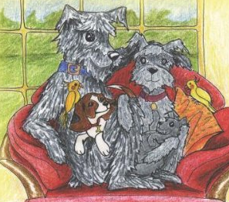
Mystery – 300 Points
What was the main character’s name in the adoption book we read?
2025

Slide 23
Mystery – 400 Points
"Name it to _____ It" is a way of coping with strong feelings.
2025

Slide 24
Mystery – 500 Points
What was your favorite thing about the LEAF group?
2025

